Slide 1
Exploratory Data Analysis
Tebong _Roland_DSC530

Slide 2

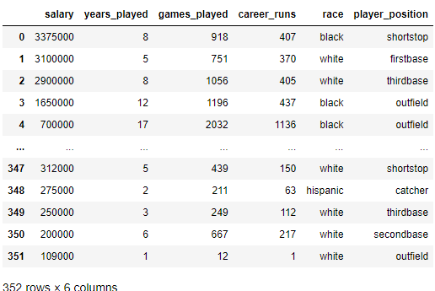
Selected variables for analysis
Salary: Salary of baseball players
Years played: Years of experience of players
Games_played: games played by a player
Career_runs: Runs scored by a player
Race: Ethnic group
Player position: Position of player in ground

Slide 3
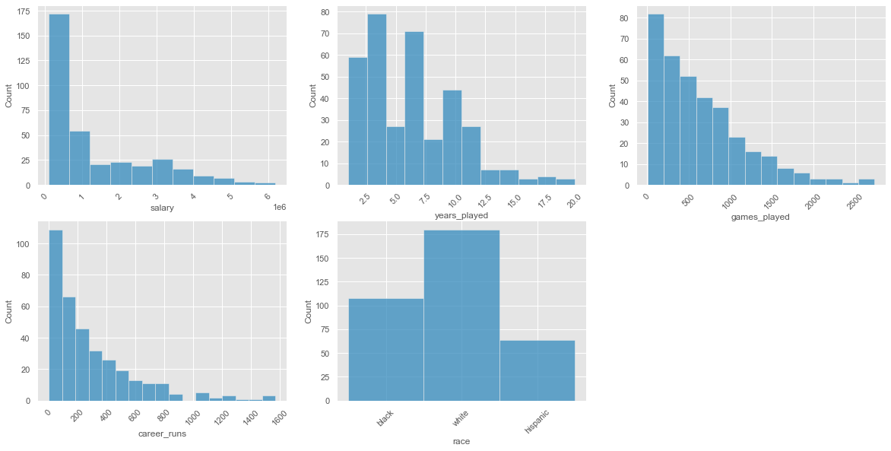
Histogram of variables
The plot on left shows histogram of all selected variables namely salary, years played, games played, career runs and race of players.

Slide 4
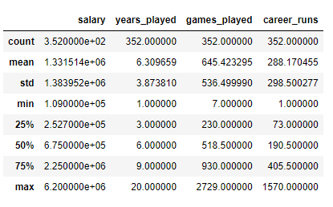
Description of variables
The plot on the left shows the mean, standard deviation, minimum, maximum and different percentiles of numerical variables in our data.

Slide 5
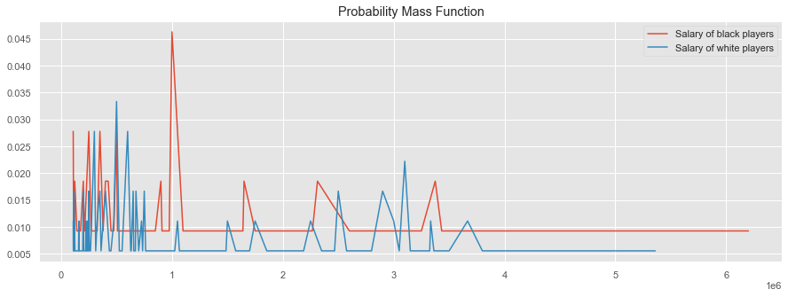
Probability Mass Function
The probability mass function for the salaries of basketball players from the black and white ethnic groups is displayed in the plot on the left.
In our data, we can see that the salaries of black players are higher than those of white players.

Slide 6
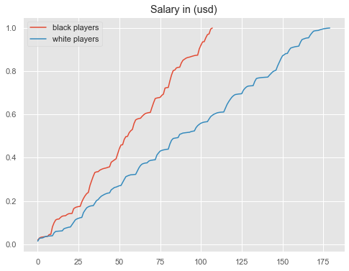
Cumulative Distributive Function
This figure makes the shape of the distributions, and the differences between them, much clearer.
We can see black player salaries are slightly higher throughout the distribution, with a larger discrepancy above the mean.

Slide 7
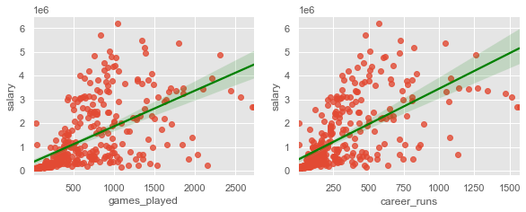
Analytical plot
From the above graphs, we can depict that each of them games_played, and career_runs have positive linear relationship with the salary of Players.
So, these three features will be very important in developing Regression Model for predictive analysis.

Slide 8
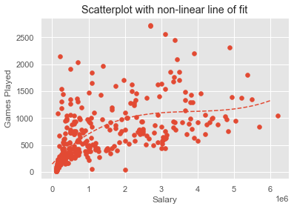
Scatterplot and correlation of variables
This plot shows the games played by the player and salary of players. We can observe that salary of players rises with rise in games played by the player.

Slide 9
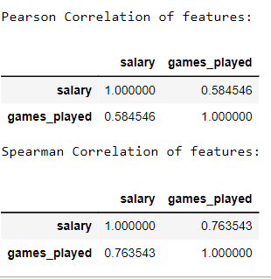
Correlation pf salary and games played by the player
Pearson coefficient works with a linear relationship between the two variables whereas the Spearman Coefficient works with monotonic relationships as well.
While we can observe from scatterplot that salary of players and games played have monotonic relationship

Slide 10
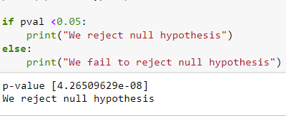
Hypothesis Test
Null Hypothesis : More years of experience and games played doesn't impact the salary of players at 95% confidence interval. Alternative Hypothesis: Mean salary of the players increases with more years of Experience and games played by the player at 95% confidence interval.

Slide 11
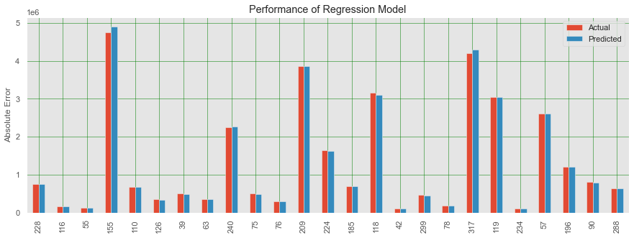
Regression Model
We have to developed a regression model that predicts the salary of players based on different features. We’ll implement mudpie variable regression model where 3 variable years payer, games played, and career run will be sued as predictor and salary of players as target variable.
The plot on the left shows the actual and predicted values for salaries by regression model.

Slide 12
THE END

